Slide 1

BD95841MUVEVK-101 Measurement Report
March 10th, 2014
Hosted by: Xuan Dang

Slide 2
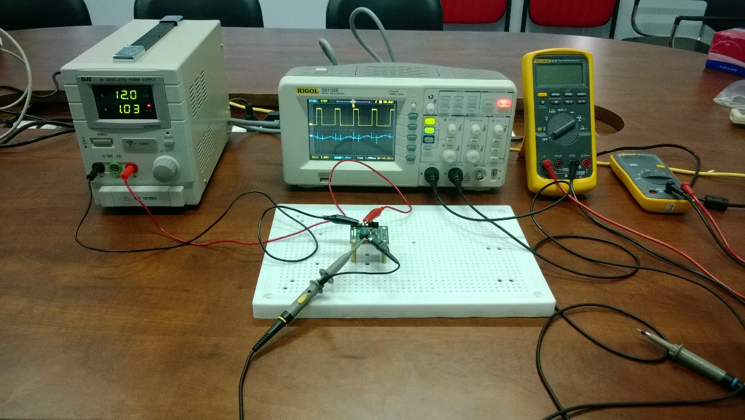
Equipment list
Regulated DC Power Supply
QJE QJ3005XE (0-30V/5A)
Multimeter:
Fluke 87V True RMS
Fluke 106
Oscilloscope
Rigol DS1102E
Electronic Load
B&K BK8500
Current probe
RP1001C

Slide 3
Functional Test
Testing procedure
Connect DC Supply to: [+]V_{IN}(TP1) and [-]GND(TP3) when EN is off. Set output of DC Supply in range from 7.5V to 15V and turn it on.
Connect Electronic Load to: [+]V_{OUT}(TP2) and [-]GND(TP4). Power on Electronic Load, set input of Electronic Load to 4A and turn on load.
Move J1 header to turn EN on.
Result:
V_{IN} = 7.5V ~ 15V
I_{OUT} = 4A
V_{OUT} = 3.265V ~ 3.317V. Test passed.

Slide 4
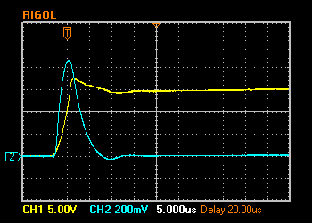
Hot Plugging Test
Test condition
V_{IN} = 15V
I_{OUT} = 4A
With original diode D1: SMAJ12A
Result:
I_{IN MAX}= 86.4A
V_{IN} peak transient voltage is 17.6V > V_{IN} Maximum Rating (15.2V)
V_{IN} 5V/Div. (DC)
I_{IN} 20A/Div. (AC)

Slide 5
Circuit Quiescent Current Measurement
Test condition
V_{IN} = 0-15V
With SMAJ12A and LED
Room temperature 25ºC

Slide 6
Efficiency Measurements
Test condition
V_{IN} = 12V
V_{OUT} = 3.3V
With SMAJ12A and LED
Room temperature 25ºC

Slide 7
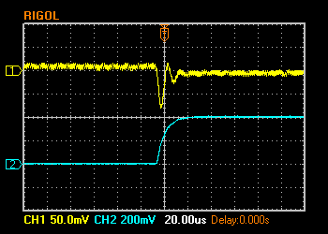
Load Response Measurements
Load response characteristic
(V_{IN}=12V, V_{OUT}=3.3V, I_{OUT}=0 → 4A)
V_{OUT} 50mV/Div. (AC)
I_{OUT} 2A/Div. (DC)

Slide 8
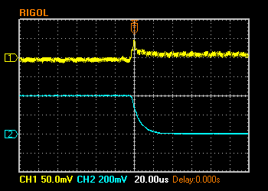
Load Response Measurements (cont.)
Load response characteristic
(V_{IN}=12V, V_{OUT}=3.3V, I_{OUT}=4A → 0)
V_{OUT} 50mV/Div. (AC)
I_{OUT} 2A/Div. (DC)

Slide 9
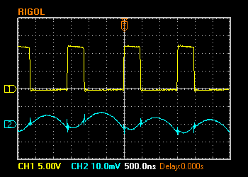
Ripple Response Measurements
V_{OUT} Ripple voltage
(V_{IN}=12V, V_{OUT}=3.3V, I_{OUT}=4A)
V_{SW} 5V/Div. (DC)
V_{OUT} 10mV/Div. (AC)

Slide 10
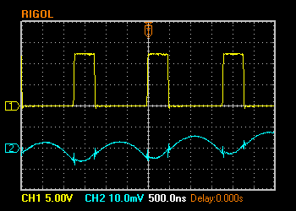
Ripple Response Measurements (cont.)
V_{OUT} Ripple voltage
(V_{IN}=12V, V_{OUT}=3.3V, I_{OUT}=0A)
V_{SW} 5V/Div. (DC)
V_{OUT} 10mV/Div. (AC)

Slide 11
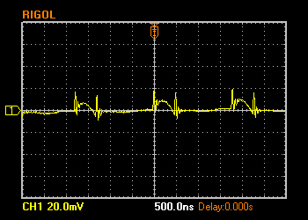
Input Voltage Ripple Measurements
V_{IN} Ripple voltage
(V_{IN}=12V, V_{OUT}=3.3V, C_{IN}=10uF (x2)+ 0.1uF, I_{OUT}=0A)
V_{IN} 20mV/Div. (AC)

Slide 12
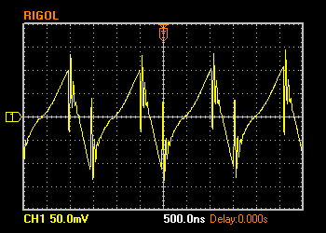
Input Voltage Ripple Measurements (cont.)
V_{IN} Ripple voltage
(V_{IN}=12V, V_{OUT}=3.3V, C_{IN}=10uF (x2)+ 0.1uF, I_{OUT}=4A)
V_{IN} 50mV/Div. (AC)

